Slide 1
Compact Composite Object (ID: 511)
OMA DMSO Weekly Conference
Rajat Kandoi
Ericsson Research, Finland
2023-10-24

Slide 2
Purpose and Agenda
Purpose:
Creating a technical enabler for the CC Object
Agenda:
Quick recap of CC Object
Way of working / next steps

Slide 3
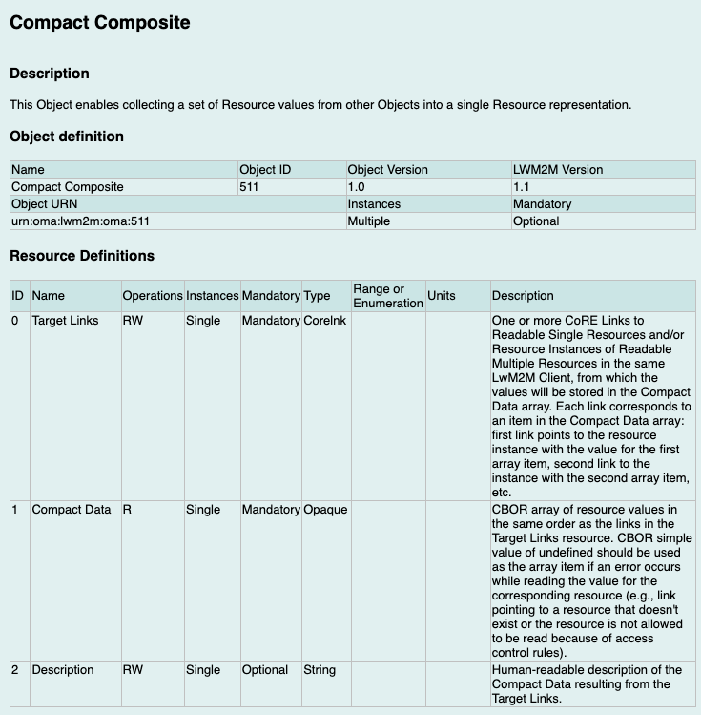
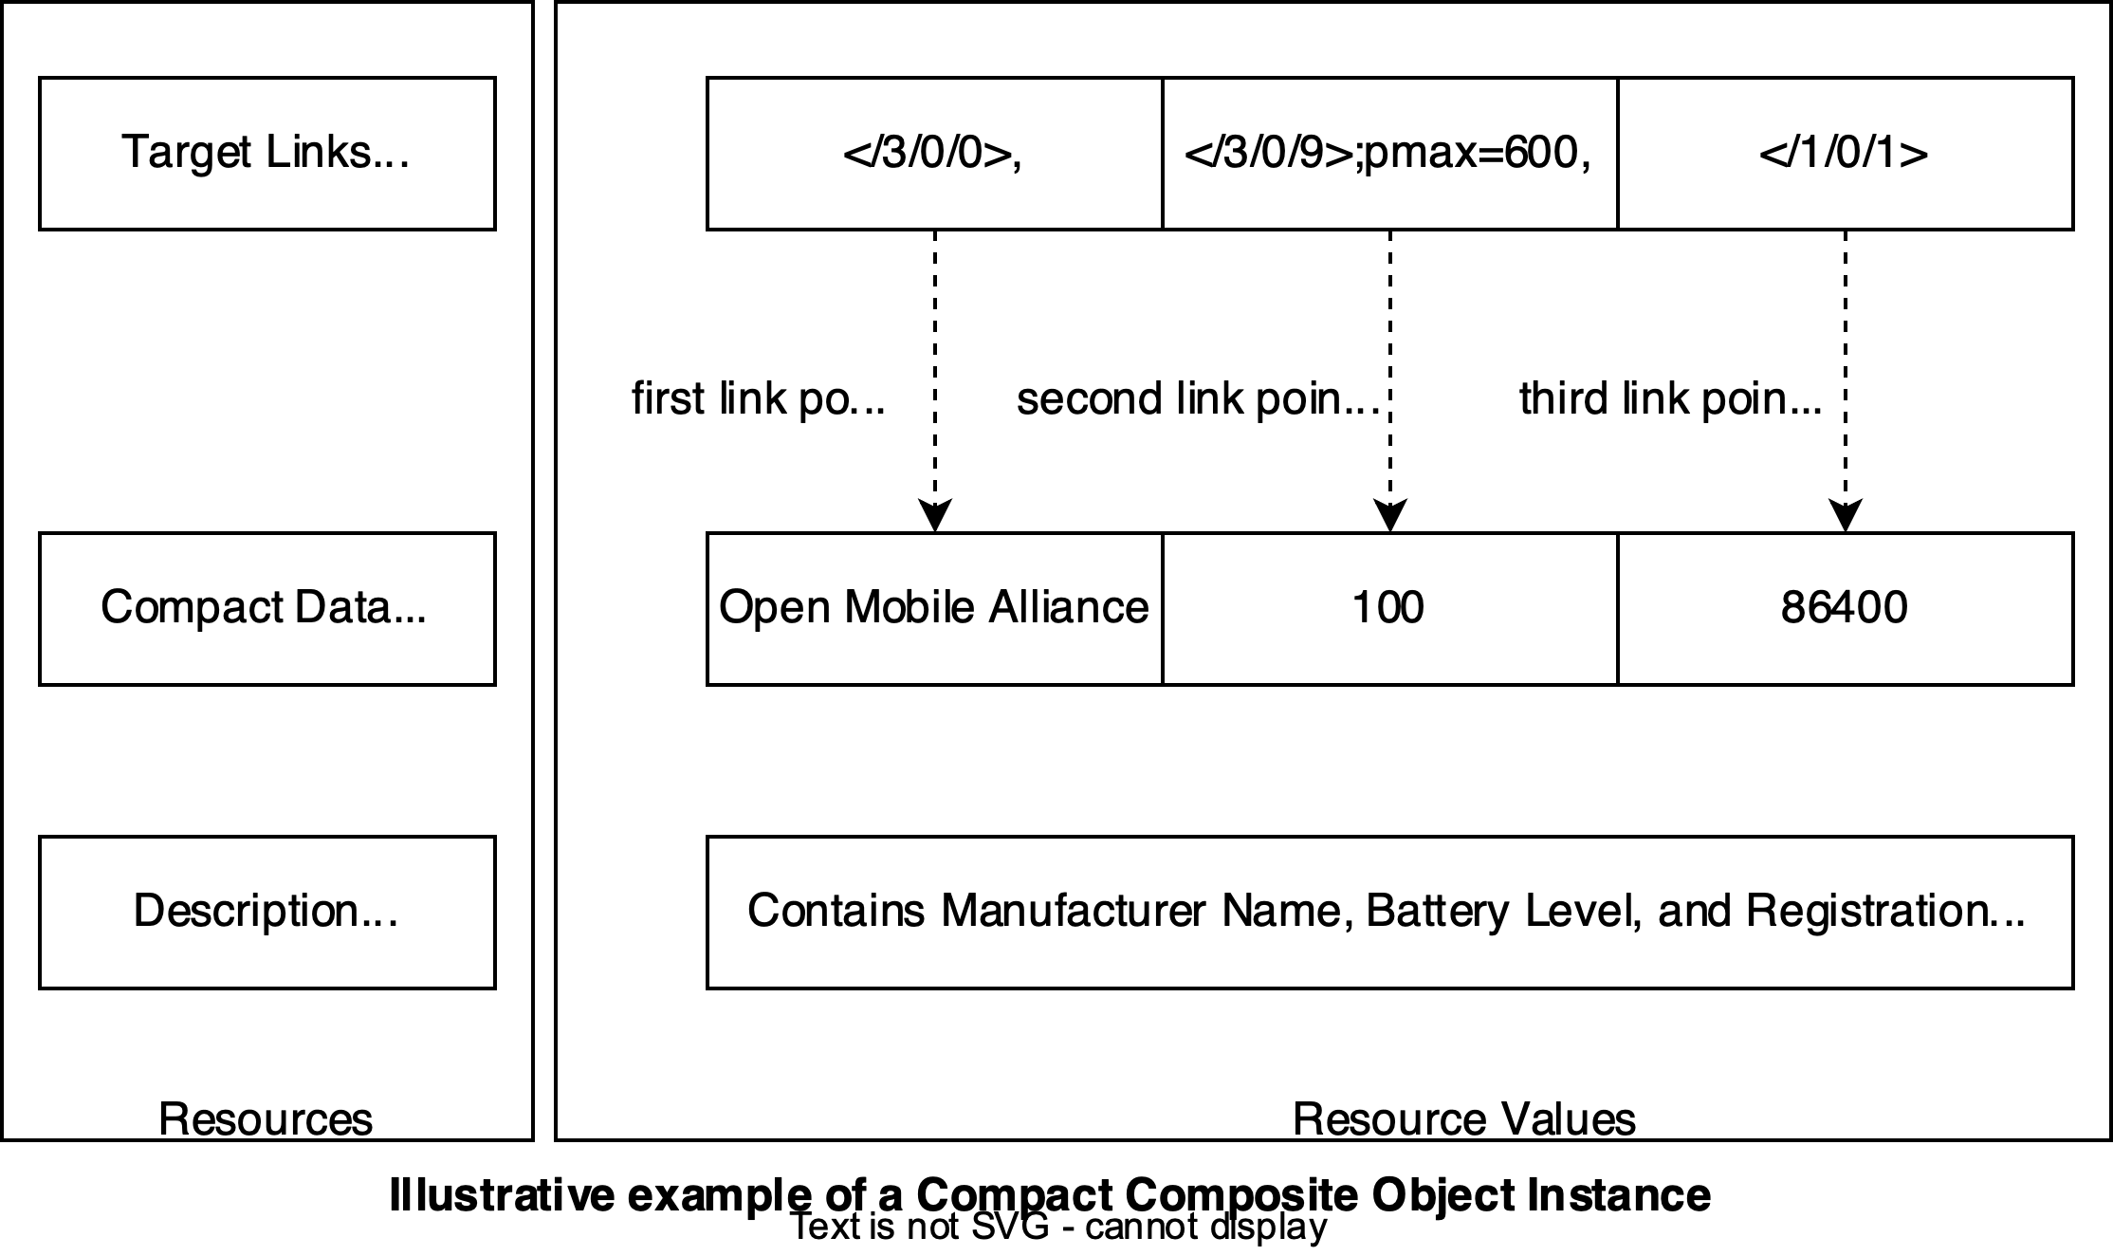
CC Object - Recap
Link to LwM2M Registry

Slide 4
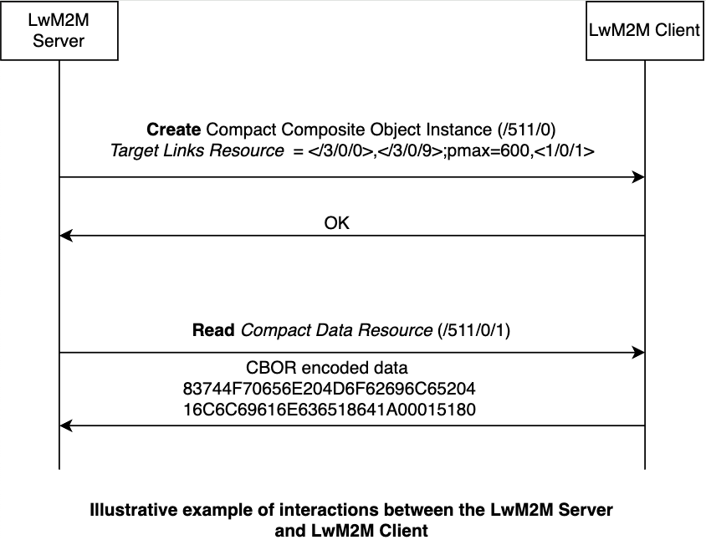
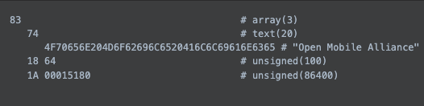
CC Object - interactions

Slide 5
Benefits of the approach
Bundling values that make sense together
  E.g.: Measurement value and unit, latitude and longitude, etc.
Regulatory compliance
  Past examples (from health domain) were raised in OMA
Energy efficiency
  via less data transmission, especially benefial in constrained environments
Discoverability of semantics is still possible
  But requires an additional step

Slide 6
Current status and Next steps
Repository created:
  https://github.com/OpenMobileAlliance/compact-composite
  First draft published in “Informative” format
Supporting companies?
Contributions
  Please make comments on the repo directly. Or Email: rajat.kandoi@ericsson.com
  Design choices
    Some are mentioned in the draft, others in todo (README). If others come to mind, please let me know

Slide 7
Feedback on open questions
Handling of race conditions is yet to be elaborated (e.g. - Writing of Target Links and read of Compact Data happens at same time)
Do we want to include any numbers / performance gains?
  I have some indicative numbers available but might be good to agree on a set of resources for comparison purposes. One option is to use only the existing example, and another option is to add more examples.
Handling of multiple instances could/should perhaps be mentioned. But what guidance can be provided? And is such guidance part of Normative documents?
Should there be any mention of potential future extensions for Write or support multiple formats for Target Links?

Slide 8
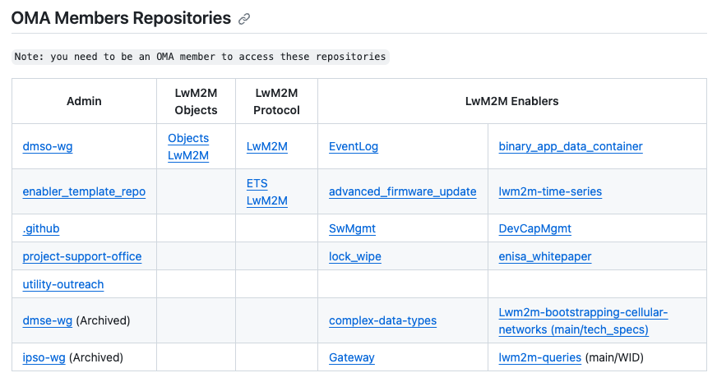
How will the enabler become public?
Should add the CC enabler to the list?
But its an internal repo - how will this work make it to the public domain?
Answer not needed immediately but good to plan

Slide 9
Next steps
Contributions
  Please make comments on the repo directly. Feel free to make PRs too (in fact encouraged ☺)
  Can reach out by email too: rajat.kandoi@ericsson.com
Design choices
  Some are mentioned in the draft, others in todo (README). If others come to mind, please let me know

